Slide 1

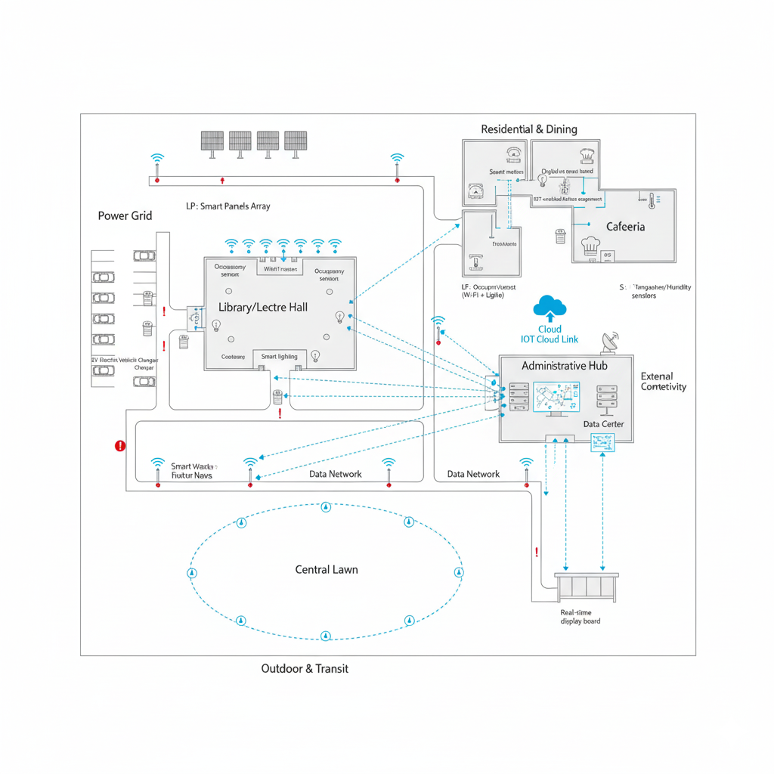
AI Chatbots for Smart Campus Governance at GIKI
A campus like GIKI need intelligent systems to enhance student services and reduce administrative load.
AI chatbots are evolving from simple FAQ bots to context-aware assistants that handle everything from course reminders to real-time campus updates.
This presentation explores global implementations, identifies gaps, and proposes CampusConcierge—a tailored solution for GIKI.
Made By Shayan Rizwan

Slide 2





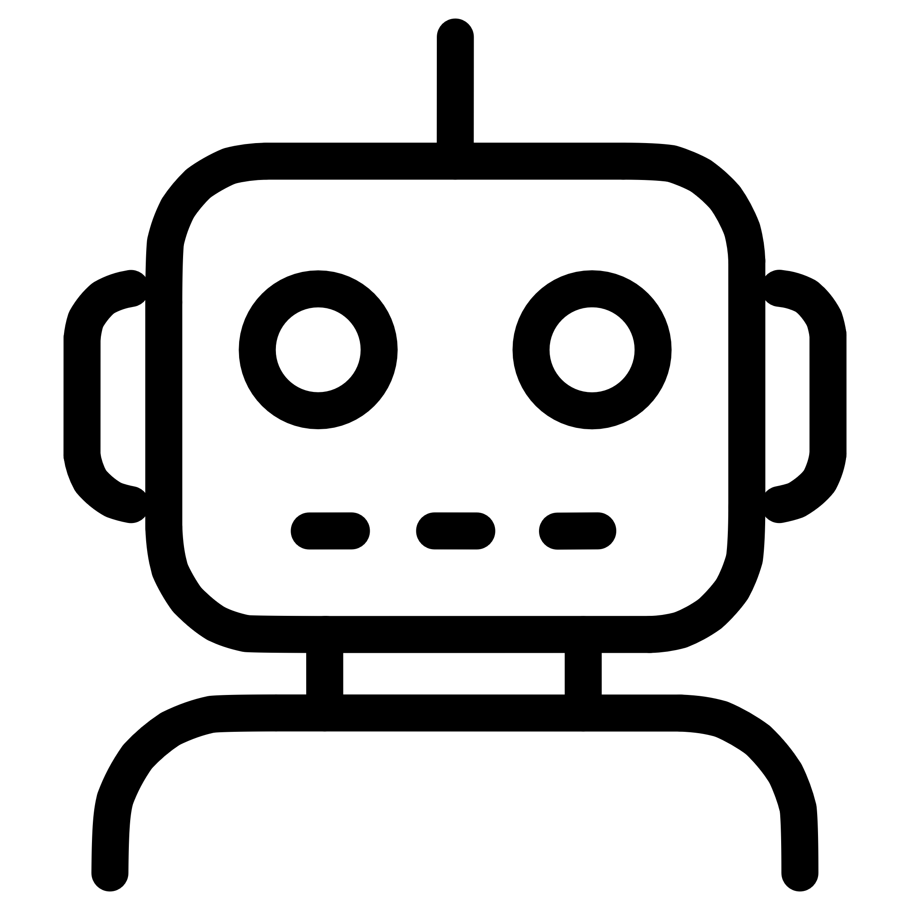

Learning from World Leaders
Here's what's working globally:
Georgia State’s “Pounce”
University of Michigan’s “Maizey”
Wittenborg University
SMS-based nudges boosted graduation rates by 22%.
RAG-based chatbot answers 3,500+ daily queries.
CRM-integrated assistant supports 5,000+ students in multiple languages.
Key Takeaway:
Chatbots can reduce staff workload by 40–60% while offering 24/7 support.
The trend is moving toward integrated, AI-driven systems that are proactive, not reactive.
Georgia State
UMich
Wittenborg
Graduation +22% via SMS nudges
3,500 queries/day with chatbot
Multilingual outreach, 5K students

Slide 3
Where Current Systems Fall Short
The Gap & Our Opportunity at GIKI
Most chatbots lack real-time data integration (e.g., library occupancy, bus locations, energy usage).
They struggle with outdated knowledge bases and don’t learn continuously from user interactions.
For GIKI—a campus with IoT potential and diverse student needs—this is a missed opportunity.
Proposed Vision: A chatbot that doesn’t just answer FAQs but also:
Tells you which study room is free right now.
Updates you on shuttle timings live.
Learns privately and securely via federated learning.

Slide 4
Introducing CampusConcierge – The Technical Core
A Smarter Chatbot for GIKI: A Hybrid RAG + IoT Architecture with Privacy-Preserving Learning
01
02
03
Multimodal Input & Intent Classification
Dynamic Knowledge Retrieval Core – The “Brain”
LLM Orchestration Layer
Voice & Text Input: User query via app/web interface.
LLM Model: Llama 3 8B (instruction‑tuned) hosted locally for privacy.
Speech-to-Text: Whisper API (OpenAI) for real-time audio transcription.
Two parallel retrieval pathways run simultaneously:
Path A: RAG Pipeline (Static & Verified Knowledge)
Prompt Engineering:
BERT-Based Intent Engine: Fine-tuned bert-base-uncased model classifies query into:
Embedding Model: all-MiniLM-L6-v2 converts FAQs into 384‑d vectors.
text You are CampusConcierge. Use ONLY the provided context. Context: [RAG_Context] [IoT_Data] Query: {user_query} Confidence Scoring: If confidence < 0.8, query routed to human agent via Zendesk API.
FAQ Retrieval (e.g., “What is the GPA requirement?”)
Vector Database: Pinecone/FAISS stores embeddings of: GIKI academic handbooks, Course catalogs, Policy documents, Past resolved tickets
IoT Query (e.g., “Is the library full now?”)
Service Request (e.g., “Book a lab session.”)
Retrieval: Top‑3 most relevant chunks returned as context.
Escalation (low confidence → human agent).
Path B: IoT Gateway (Real‑Time Data)
Sensor APIs: Pulls live data via REST/WebSocket: Library seat occupancy (ultrasonic sensors), Shuttle GPS (real‑time location), Smart meter data (energy usage)
Data Fusion: IoT context formatted into JSON snippets.

Slide 5
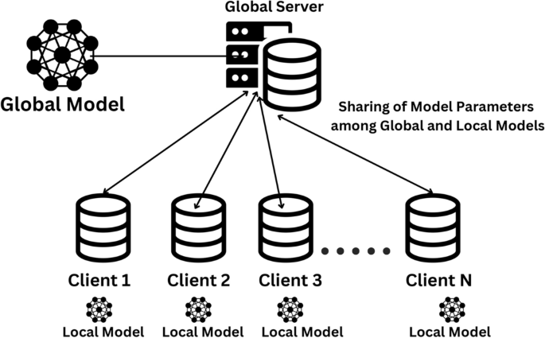

Technical Core [CONTINUED]
Federated Learning Module (Privacy‑Preserving Updates)
Deployment Stack
Microservices: Docker containers for each module.
Local Training: Anonymized query‑response pairs stored on‑premise.
Orchestration: Kubernetes for scaling during exam weeks.
Federated Averaging (FedAvg):
Integration APIs: RESTful services to connect with: GIKI Student Information System (SIS), Moodle LMS, Campus IoT sensor network
Local model updates sent every 24h to central server.
Target Performance: <2 sec response time for 95% of queries.
Only model gradients shared, never raw data.
Global Model Update: Aggregated updates improve intent classifier & LLM without violating GDPR.

Slide 6

User Input
Voice or text via mobile app
NLP Layer
BERT classifier routes intent
Data Layer
RAG & IoT pipelines in parallel
Orchestration
Llama 3 merges contexts + scorer
Response & Learning
Reply to user + federated update
Why This is Technically Superior for GIKI:
No Hallucinations: RAG grounds answers in verified GIKI documents.
Real‑Time Context: IoT integration allows queries like “Find a free lab with AC now.”
Privacy‑First: Federated learning ensures student data never leaves campus servers.
Scalable & Maintainable: Microservices allow incremental upgrades (e.g., swapping LLM, adding new sensors).

Slide 7
Implementation & Future Vision
The Road Ahead
Next Steps for GIKI:
Pilot with Academic FAQs + Library IoT sensors.
Integrate with GIKI’s SIS/LMS via secure APIs.
Deploy using microservices for scalability.
Long-Term Vision:
Voice biometrics for secure access.
Predictive analytics for student support.
Ethical AI governance & bias monitoring.
Transforming GIKI into a truly smart campus starts with intelligent, student-centered AI—making everyday campus life seamless, efficient, and responsive.

